Slide 1


Data Management Planning
Instructors: Federico Bianchini, Nazeefa Fatima
Centre for Bioinformatics, University of Oslo
6 October 2023
Life Science RDM

Slide 2
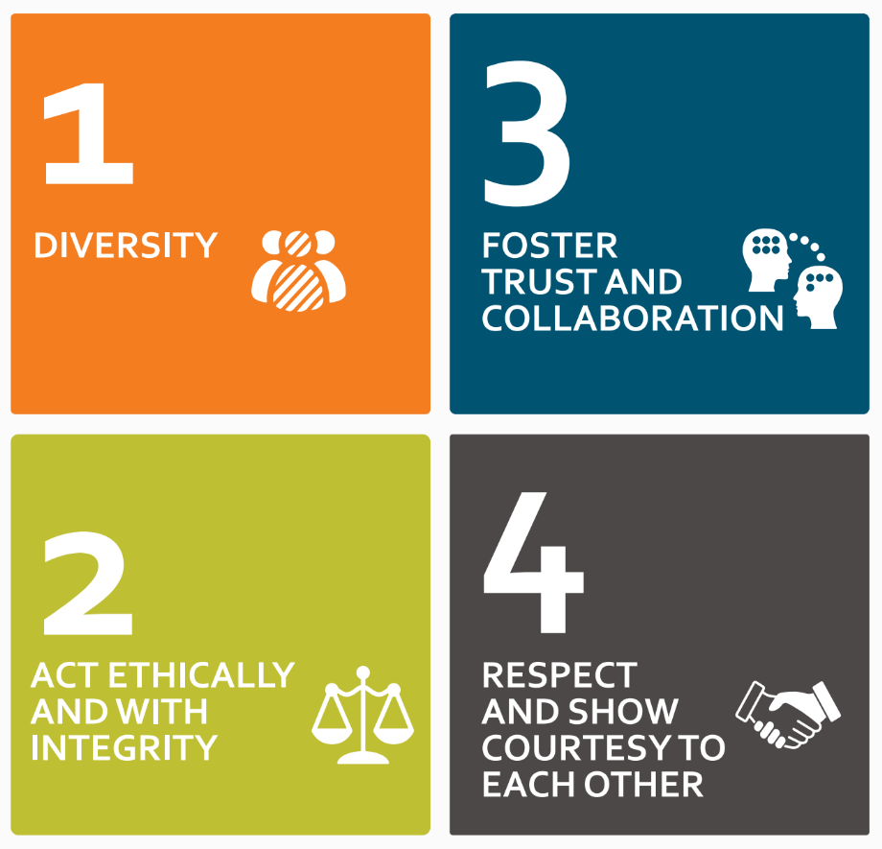
https://elixir-europe.org/events/code-of-conduct

Slide 3
Agenda
Time | Activity
09:00 | Welcome and Introduction
09:15 | Data Management Planning
09:45 | The Data Stewardship Wizard - Login Help
10:00 | The Data Stewardship Wizard – Demo
10:30 | BREAK
10:45 | Exercise: DMP evaluation – breakout rooms
11:15 | Exercise: DMP evaluation – discussion
11:45 | Wrapping up: Short quiz + workshop evaluation
Life Science RDM

Slide 4
Introduction
ELIXIR and ELIXIR Norway

Slide 5
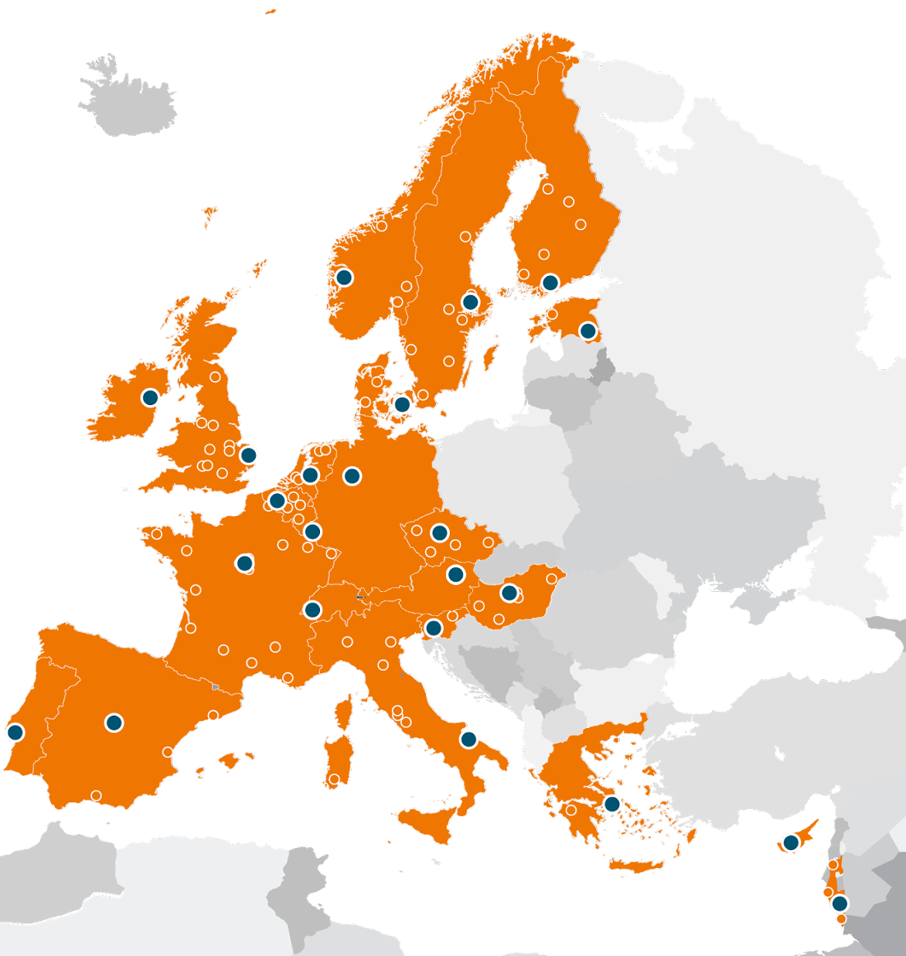






ELIXIR – what do we do
We build life science informatics capacity and infrastructure in Europe, connect and develop a network of experts and provide hundreds of high quality services and resources available to all
Databases
Training
Software tools
Data standards
Compute resources
Scientific & technical experts

Slide 6


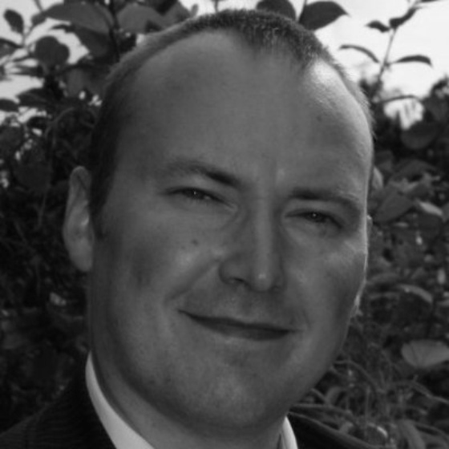
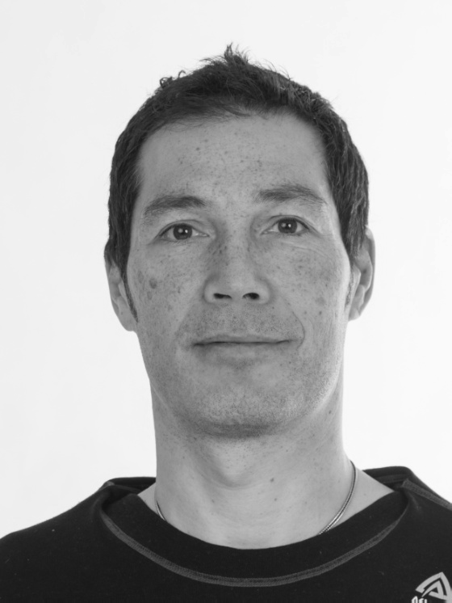

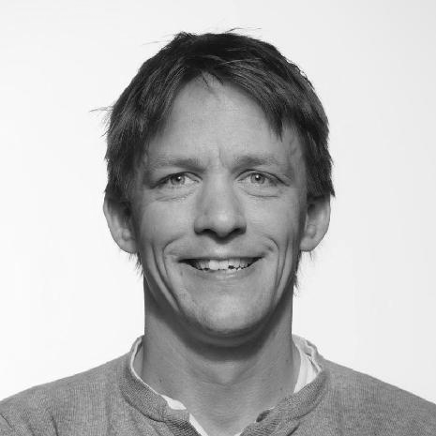
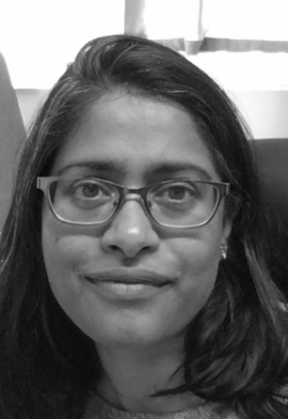

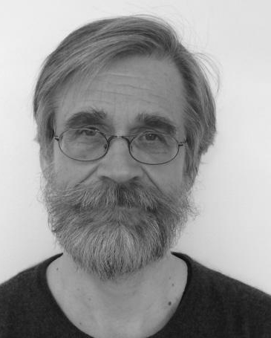
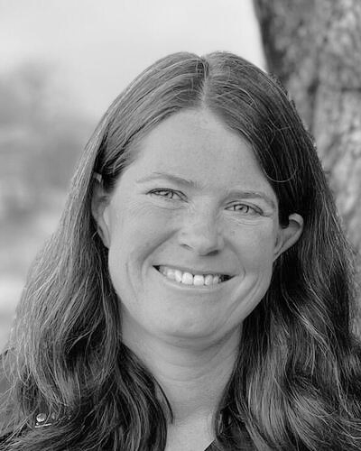


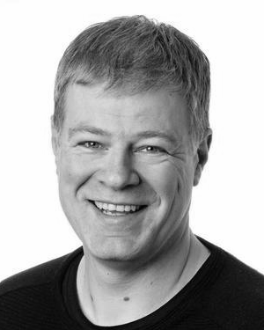

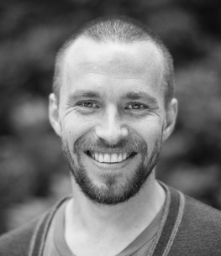

Espen Åberg
Service Coordinator
Erik Hjerde
Node Leader
UiT node
Erin Calhoun
Training Coordinator
Pål Sætrom
Node leader
Sushma Grellscheid
Head of Node
Eivind Hovig
Node leader
NTNU node
Ingeborg Winge
Node coordinator
UiO node
UiB node
Simen Rød Sandve
Node leader
NMBU node
Korbinian Bösl
Data Management coordinator
Kjell Petersen
Technical coordinator

Slide 7
Our services to Norwegian users
Support - through our nationally coordinated Helpdesk:
  Analysis
  Scripting
  Workflow development
  Data management
Training:
  Using our tools and workflows
  Data management
e-infrastructure: analysis, sharing and storage of data
  Non-sensitive data:
    NeLS - the Norwegian e-infrastructure for Life Sciences
  Sensitive data:
    TSD
    Containerised workflows on SAFE and HUNT Cloud
support@elixir.no

Slide 8
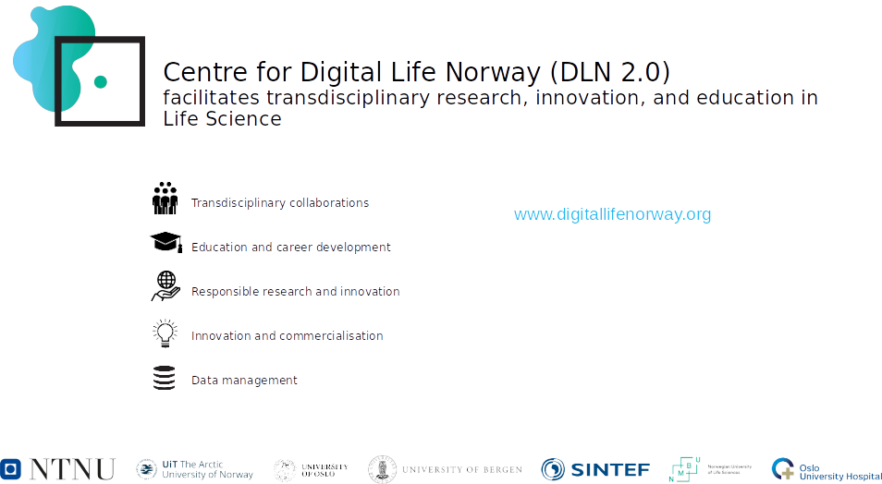

Slide 9


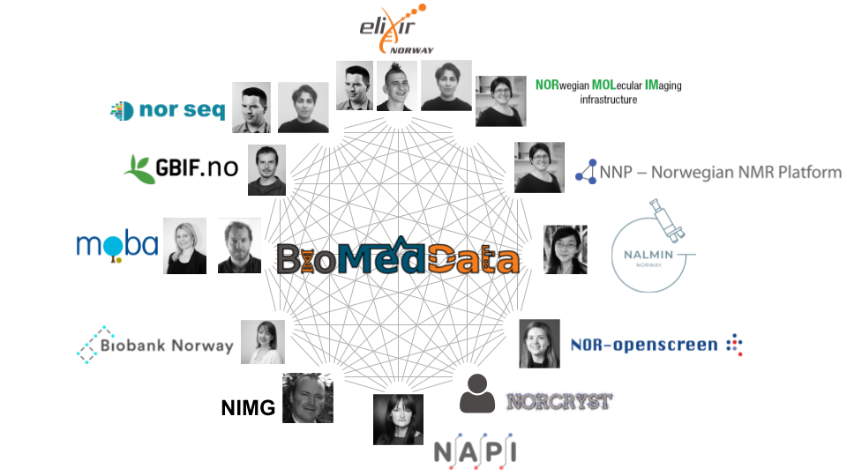
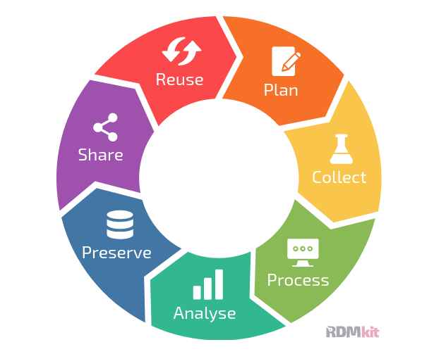
A national research infrastructure to promote FAIR management of life science data along the data life-cycle
Data Life Cycle (image) from https://rdmkit.elixir-europe.org/data_life_cycle

Slide 10
Introduction
Data Management plans and funders’ requirements

Slide 11





Research data...
...must be stored/archived in a safe and secure manner.
...must be made accessible for reuse.
...should be made accessible at an early stage [latest at publication]
...must be accompanied by standardised metadata.
...must be provided with a license for access, reuse and redistribution.
...should preferably be made accessible at no charge.
... must be described in a data management plan.
https://www.forskningsradet.no/contentassets/e4cd6d2c23cf49d4989bb10c5eea087a/the-research-council-of-norways-policy-for-open-access-to-research-data.pdf
Notes:
Approved by the research-performing institution, and made available if possible.

Slide 12

Research Council of Norway’s Policy for
Open Access to Research Data
Originally 2014, updated Dec/2017
New:
“… requiring that R&D-performing institutions or companies should assess whether projects receiving funding from the Research Council must develop a data management plan.”
and
“The FAIR Guiding Principles for scientific data management and stewardship are included as a main principle in the Research Council’s policy”
https://www.forskningsradet.no/contentassets/e4cd6d2c23cf49d4989bb10c5eea087a/the-research-council-of-norways-policy-for-open-access-to-research-data.pdf
Notes:
following the new national strategy in 2017, RCN also updated their policy for open access.
Most were as before, but they also included that:
We will come back to this in a bit.

Slide 13

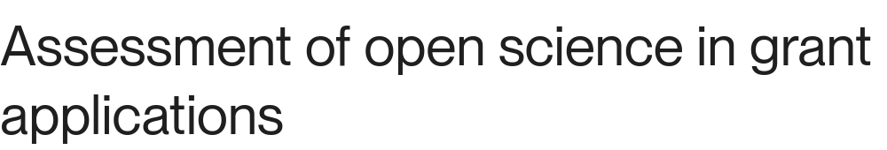
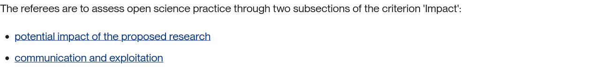

Slide 14
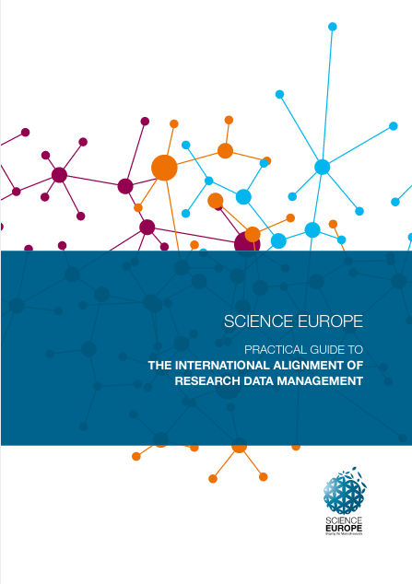
Core requirements to data management plan
6 Core Requirements:
Data description & Collection/re-use
Documentation & Data quality
Storage & Backup
Legal & Ethical requirements
Data sharing & Preservation
Responsibilities & Resources
https://www.forskningsradet.no/contentassets/e4cd6d2c23cf49d4989bb10c5eea087a/se_rdm_practical_guide_final.pdf

Slide 15

The Research Council recommends using a service for DMPs that allows the project to generate a machine-actionable DMP, for example according to the RDA Common Standard.
Until further notice, the project must upload the data management plan in the format of pdf, .doc(x) or similar. NFR is working on developing systems to facilitate machine-actionable DMP.
Assigning your data management plan a persistent identifier is strongly recommended.
https://www.forskningsradet.no/en/research-policy-strategy/open-science/research-data/

Slide 16
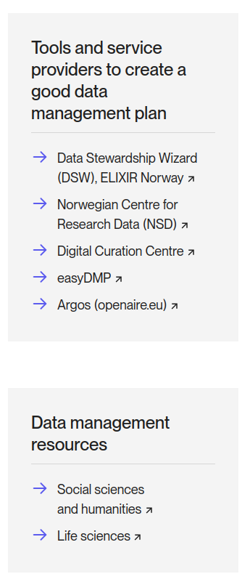


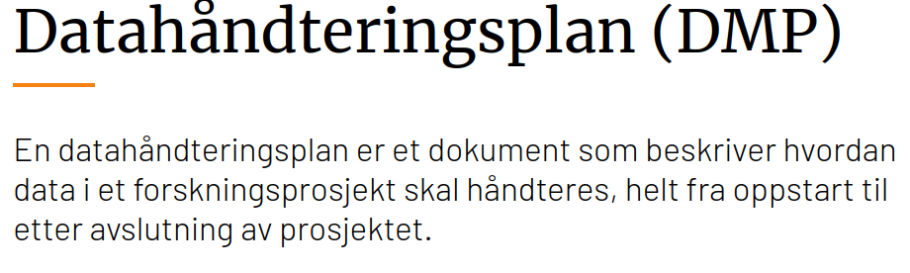

https://www.forskningsradet.no/en/research-policy-strategy/open-science/research-data/

Slide 17

A quick introduction to the FAIR principles:
Many concepts will become clearer as the workshop progresses,
but it is useful to have a general idea at this early stage.
General guiding principles
  Not domain specific
  Not refer to a specific technological implementation
  Aimed at automatisation / machine-actionability
https://www.go-fair.org/fair-principles/

Slide 18
Introduction
The FAIR data principles

Slide 19

Open Data
As open as possible and as close as necessary
Data that is not open should also be FAIR
A system for authentication and authorisation should be in place

Slide 20

FAIR: Findable Data
Metadata are crucial: the data are found through the metadata.
Deposition on a repository is one of the FAIR principles, such an (external) service has to be in place.

Slide 21
FAIR: Accessible Data
Technical implementations for accessing data, authentication and authorisation (FAIR not OPEN).
Metadata always available, also when the dataset no longer exist.

Slide 22
FAIR: Interoperable Data
Adoption of community-defined standards and definitions.
Consistent metadata annotation allows linking across datasets.

Slide 23
FAIR: Reusable Data
To ensure successful reusability, you need:
Rich metadata
License
Data “history” (experimental technique, author, publication)
Community standards (e.g. from domain repository of choice)
Notes:
Lack of license
Provenance: where is data coming from

Slide 24
Introduction
The Machine-Actionable DMP standard

Slide 25
The machine-actionable DMP standard (maDMP)
Machine-actionable:
Information structured in a consistent way so that machines can be programmed against the structure.
Formats such as JSON, XML, RDF
Standard:
Contains “minimum information”, but can also be customised.
All tools supporting this format become interoperable

Slide 26
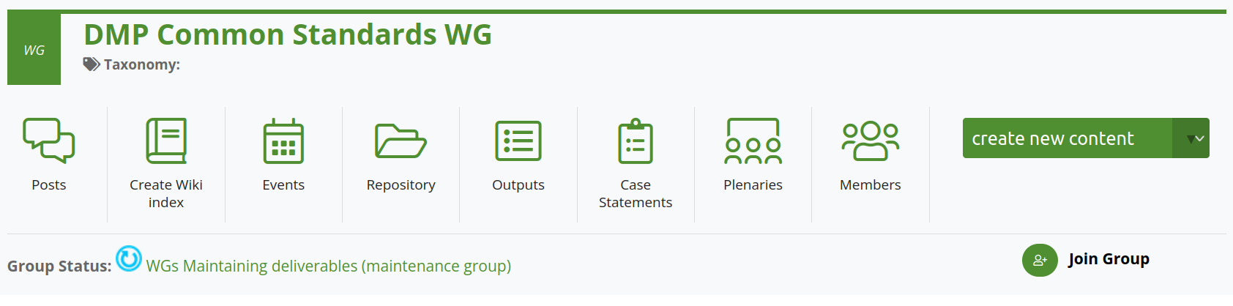

Research Data Alliance (RDA) working group (WG)
https://www.rd-alliance.org/groups/dmp-common-standards-wg

Slide 27

Who recommends/requires a maDMP 1
What a data management plan should include
The Research Council recommends using a service for data management plans that allows the project to generate a machine-actionable data management plan, for example according to the RDA Common Standard. Until further notice, the project must upload the data management plan in the format of pdf, .doc(x) or similar. We are working on developing our systems to facilitate machine-actionable data management plans. We also recommend assigning your data management plan a persistent identifier, such as a DOI. Several services for data management plans offer this.
https://www.forskningsradet.no/en/research-policy-strategy/open-science/research-data/

Slide 28
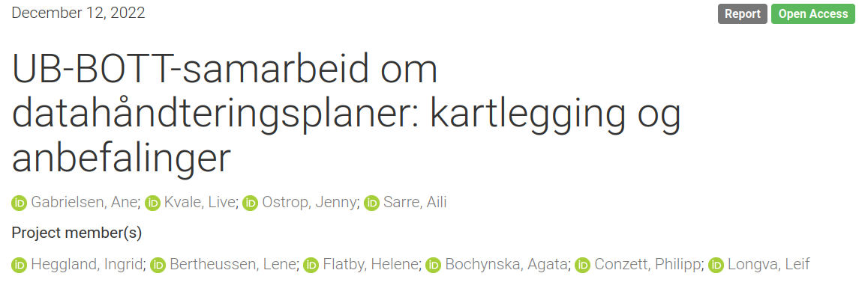
Who recommends/requires a maDMP 2
https://doi.org/10.5281/zenodo.7428542

Slide 29
Who recommends/requires a maDMP 2
Prosjektgruppen slutter seg også til anbefalingen fra Forskningsrådet om å bruke verktøy som kan generere maskinhåndterbare datahåndteringsplaner (f.eks. etter RDA Common Standard) og publisering av DMPer.
https://doi.org/10.5281/zenodo.7428542

Slide 30
JSON schema
A JSON schema is a specification of the structure of a JSON file.
It allows e.g. to restrict the types that can enter the various fields of the JSON file. Schemas can thus be used to validate the content of a file.
Schema for the maDMP is available at: https://github.com/RDA-DMP-Common/RDA-DMP-Common-Standard/blob/master/examples/JSON/JSON-schema/1.1/maDMP-schema-1.1.json

Slide 31
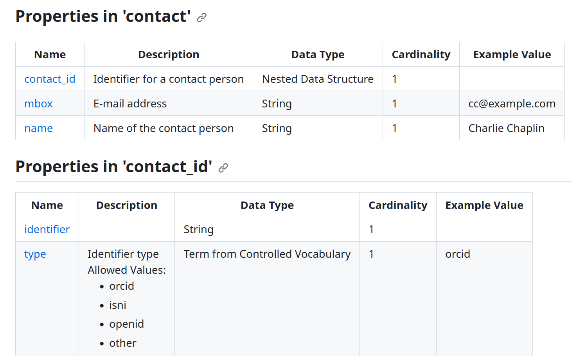
JSON schema of maDMP

Slide 32
JSON schema of maDMP
This specific format is already implemented in DSW.
Filling out a DMP produces a document compliant with maDMP
This will be demonstrated in the next session.

Slide 33
Introduction
Knowledge bases and signposting

Slide 34

Research Data Management Kit
A user-oriented guide to the FAIR RDM practices in life sciences
increase
self-sufficiency
support researchers to know and utilise RDM services
build capacity and skills in every research institute
pool the expertise of the community for the community
Built by life scientists and data stewards
A sustainable, open, ongoing community effort
https://rdmkit.elixir-europe.org

Slide 35
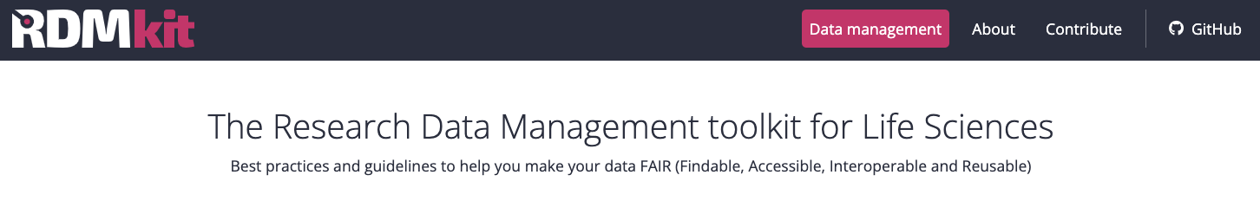
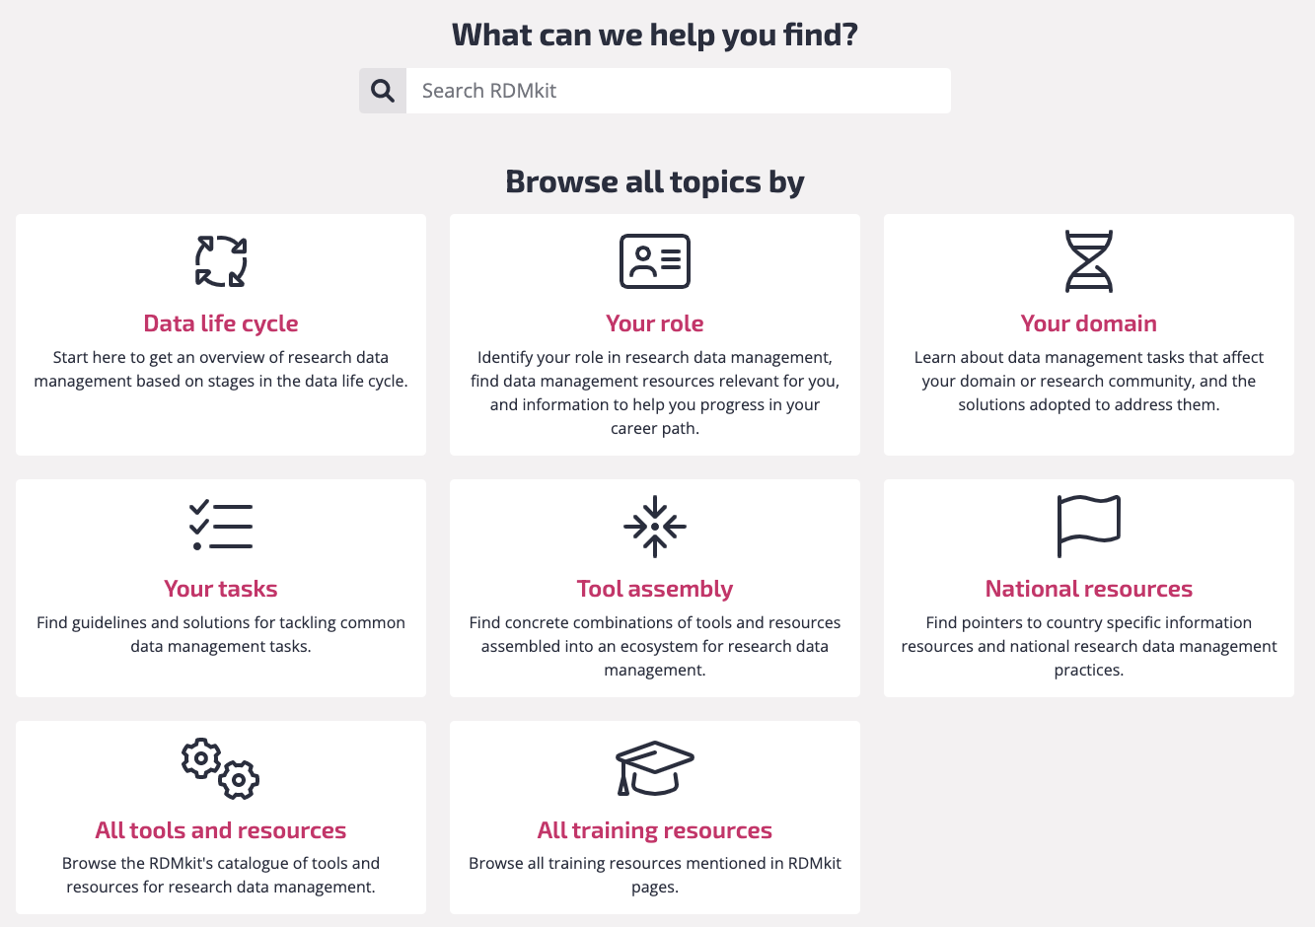



RDMkit: Website Walkthrough

Slide 36


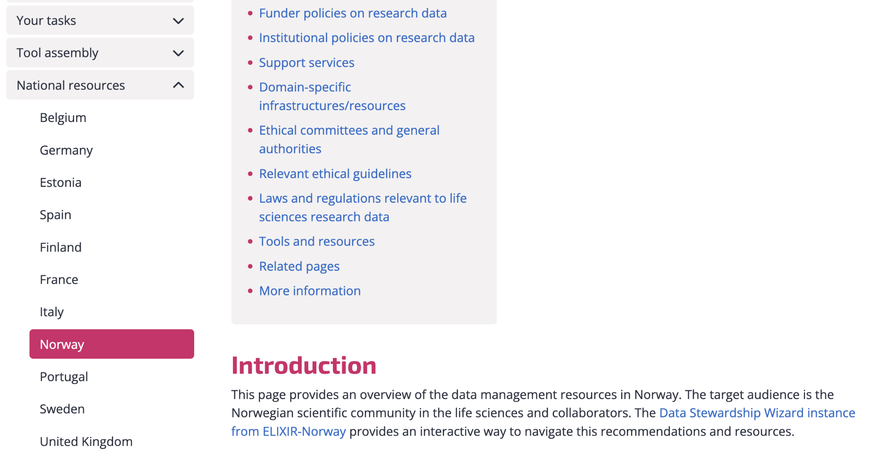
RDMkit: National resources in Norway
https://rdmkit.elixir-europe.org/no_resources
Notes:
We have a page for Norway; where you will find:
country-specific policies on open science
national regulations on data ethics, such as some we covered today
and domain-specific infrastructures and tools.

Slide 37

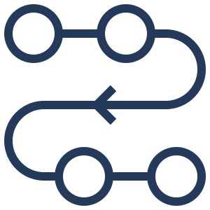



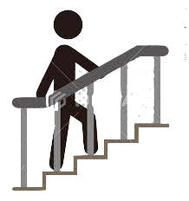
RDMkit: A sustainable, open, expanding community effort
Simple, sustainable platform
Contribution and editorial processes
Guidelines, process documents and data are made available under a CC-BY license.
Contentathons and focus groups
Software is made available under an MIT license.
Low barrier for contributions
Notes:
Coordinates by ELIXIR nodes. Including ELIXIR members and beyond

Slide 38
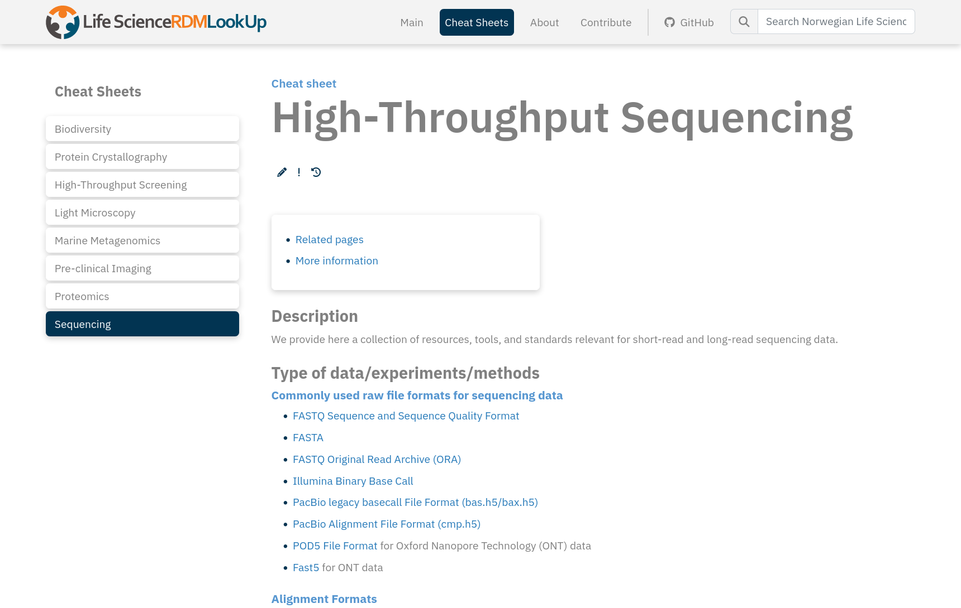

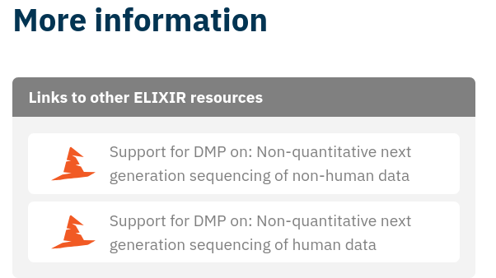

https://elixir.no/rdm-lookup

Slide 39
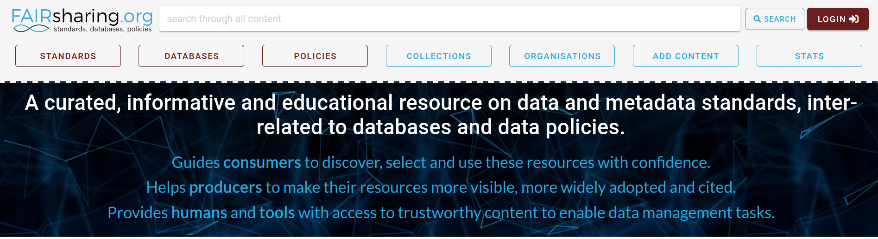
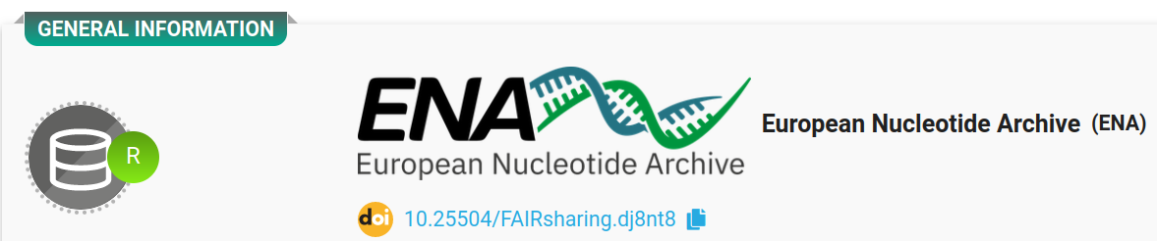
Example top page for the European Nucleotide Archive:
Recommendation

Slide 40



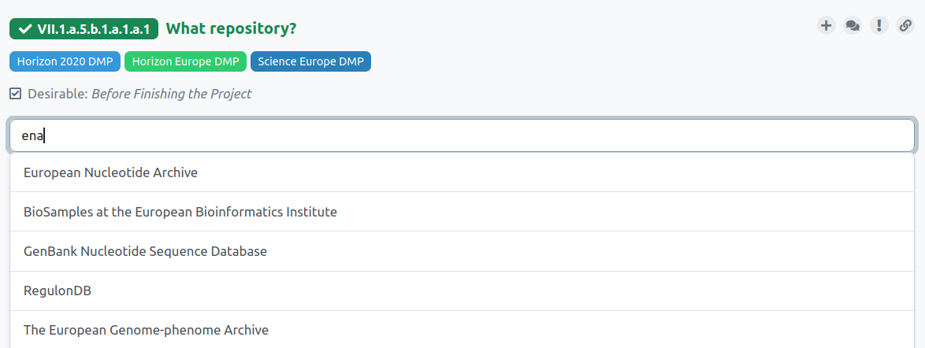

DSW FAIRsharing integration

Slide 41


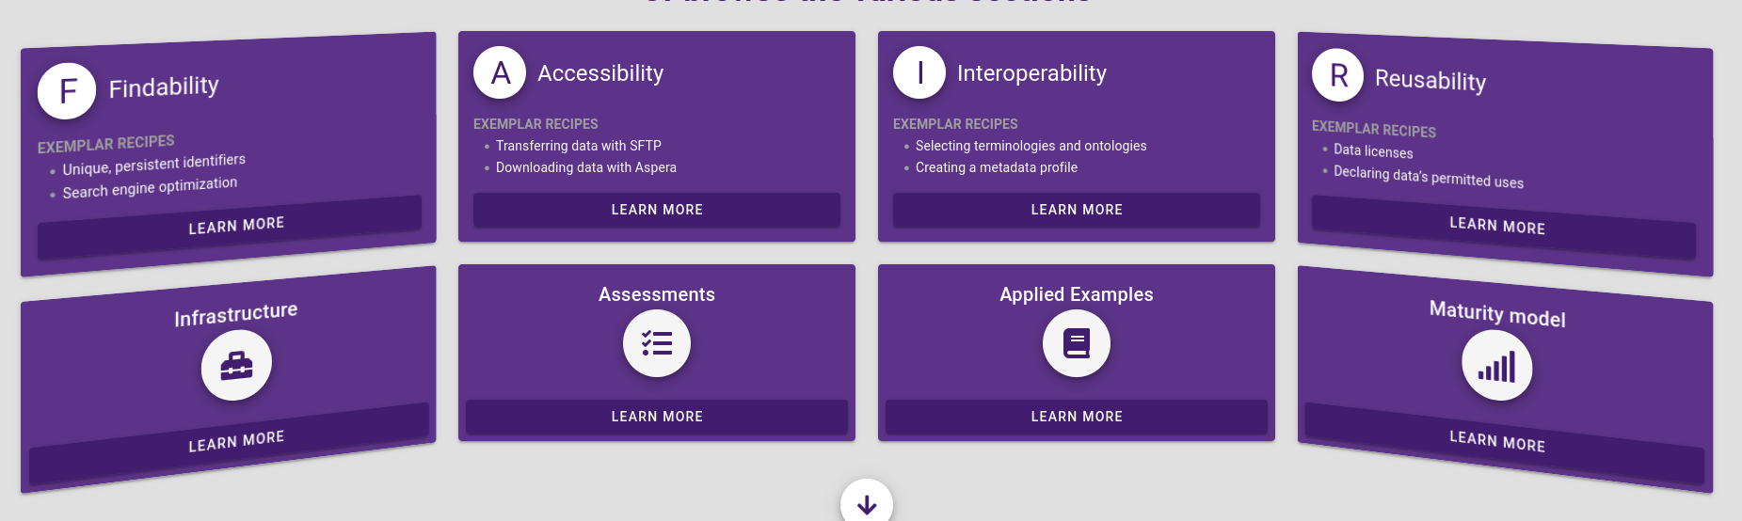
https://faircookbook.elixir-europe.org/

Slide 42
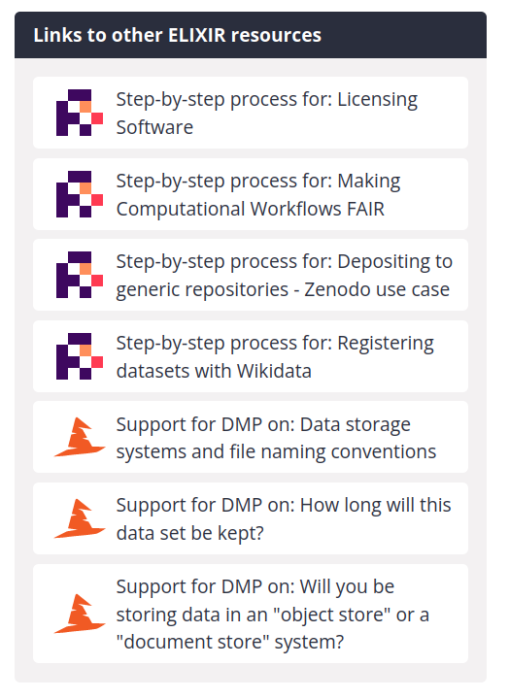
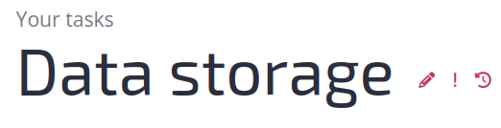
RDMkit: Integrations
https://rdmkit.elixir-europe.org/storage
Integration with DSW for the relevant portions of a standard DMP
Integration with FAIR Cookbook for associated technical solutions
Integration with registries such as FAIRsharing for standards and databases and TeSS for training

Slide 43
Thank you!
Elixir-norway.org
@elixirnorway
support@elixir.no
Except where otherwise noted, this work is licensed under a
Creative Commons Attribution 4.0 International License
https://creativecommons.org/licenses/by/4.0/

